Slide 1
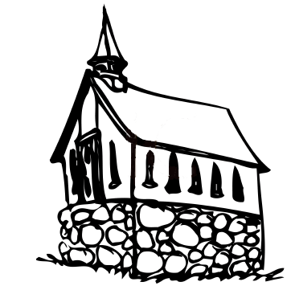
The Church that Jesus Built
“And on this rock I will build My church, and the gates of Hades shall not prevail against it”
Matthew 16:18
Notes:
Preached at West Side on April 14, 2013 AM
Print Slides: 12,15,16

Slide 2
The Church that Jesus Built
A house made of spiritual stones
1 Peter 2:5; 1 Timothy 3:15; Isaiah 2:2-3

Slide 3
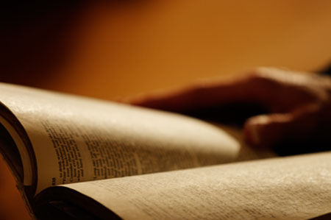
1 Peter 2:5
You also, as living stones, are being built up a spiritual house, a holy priesthood, to offer up spiritual sacrifices acceptable to God through Jesus Christ.

Slide 4
1 Timothy 3:15
But if I am delayed, I write so that you may know how you ought to conduct yourself in the house of God, which is the church of the living God, the pillar and ground of the truth.

Slide 5
Isaiah 2:2-3
Now it shall come to pass in the latter days that the mountain of the Lord’s house shall be established on the top of the mountains, and shall be exalted above the hills; and all nations shall flow to it. ³ Many people shall come and say, “Come, and let us go up to the mountain of the Lord, to the house of the God of Jacob; He will teach us His ways, and we shall walk in His paths.” For out of Zion shall go forth the law, and the word of the Lord from Jerusalem.

Slide 6
The Church that Jesus Built
A house made of spiritual stones
1 Peter 2:5; 1 Timothy 3:15; Isaiah 2:2-3
The Builder – Jesus
Matthew 16:18

Slide 7
Matthew 16:18
And I also say to you that you are Peter, and on this rock I will build My church, and the gates of Hades shall not prevail against it.

Slide 8
The Church that Jesus Built
A house made of spiritual stones
1 Peter 2:5; 1 Timothy 3:15; Isaiah 2:2-3
The Builder – Jesus
Matthew 16:18
The Place of Origin – Jerusalem
Isaiah 2:2-3; Acts 1:4,12; Acts 2:1-14

Slide 9
Isaiah 2:2-3
Now it shall come to pass in the latter days that the mountain of the Lord’s house shall be established on the top of the mountains, and shall be exalted above the hills; and all nations shall flow to it. ³ Many people shall come and say, “Come, and let us go up to the mountain of the Lord, to the house of the God of Jacob; He will teach us His ways, and we shall walk in His paths.” For out of Zion shall go forth the law, and the word of the Lord from Jerusalem.

Slide 10
Acts 1:4,12
And being assembled together with them, He commanded them not to depart from Jerusalem, but to wait for the Promise of the Father, “which,” He said, “you have heard from Me;

Slide 11
Acts 2:14
But Peter, standing up with the eleven, raised his voice and said to them, “Men of Judea and all who dwell in Jerusalem, let this be known to you, and heed my words.

Slide 12
The Church that Jesus Built
A house made of spiritual stones
1 Peter 2:5; 1 Timothy 3:15; Isaiah 2:2-3
The Builder – Jesus
Matthew 16:18
The Place of Origin – Jerusalem
Isaiah 2:2-3; Acts 1:4,12; Acts 2:1-14
The Time of Origin – Pentecost
Matthew 16:18; Acts 2:1,41,47

Slide 13
Matthew 16:18
And I also say to you that you are Peter, and on this rock I will build My church, and the gates of Hades shall not prevail against it.

Slide 14
Acts 2:1,41,47
(1), When the Day of Pentecost had fully come, they were all with one accord in one place.
(41), Then those who gladly received his word were baptized; and that day about three thousand souls were added to them.
(47), And the Lord added to the church daily those who were being saved.

Slide 15
Builder – Place – Time (Denominational Churches)
Lutheran (Martin Luther/Germany/1520)
Episcopalian (Henry VIII/England/1534)
Presbyterian (John Calvin/Switzerland/1536)
Baptist (John Smythe/Holland/1607)
Methodist (John Wesley/England/1739)
Mormon (Joseph Smith/America/1830)
Adventist (William Miller/America/1830)
Ch. Scientists (Mary Baker Eddy/America/1866)
Jeh. Witnesses (Charles Russell/America/1872)

Slide 16
Conclusion
The denominational concept is flawed. We should all seek to be a member of the one church built by the Lord, started in Jerusalem on the first Pentecost following the resurrection of our Lord.

